Slide 1
Oscar Wins/Losses Analysis
Under Student's T-Test
Submitted by : Aashna Gandhi (S052)
Kinjal Joshi (S057)
Krisha Desai (S061)
Mentors : Mr. Sagar Sankeshwari
Dr. Hemant Kulkarni

Slide 2
Overview
Introduction to the topic
Graphs
Project Objectives
Inference
Literature Review
Conclusion
Project Timeline
Webliography
Methodology
Acknowledgement

Slide 3

INTRODUCTION TO THE TOPIC
Every year the Academy Awards (known commonly as The Oscars) recognize excellence in cinema as assessed by the Academy’s voting membership. It is commonly recognized as the most prestigious of the movie awards and draws a lot of global interest. However, this project is focused on how the views of the general film viewing public about the properties associated with movies, affect the chance of it winning an Academy award. In this analysis, the general public will be represented by the Internal Movie Database (IMDb), a website that serves as an online database of world cinema which contains a large number of public data on films such as the title of the film, the year of release of the film, the genre of the film, the audience, the rating of critics, the duration of the film, the summary of the film, actors, directors and much more.

Slide 4
The First Objective
To check how the movie IMDB ratings have affected the chance of it winning an Academy Award in the years 2010-2016.
Project
Objectives
The Second Objective
To check how the genre of the movie has affected the chance of it winning an Academy Award in the years 2010-2016.
The Third Objective
To check whether having an Oscar award winning director affects the movie rating and thereby the chance of it winning an Academy Award in the years 2010-2016.

Slide 5
Student's T-Test
Chi-Square test of Independence
Shapiro Wilk Test
Wilcoxon Test
LITERATURE REVIEW

Slide 6
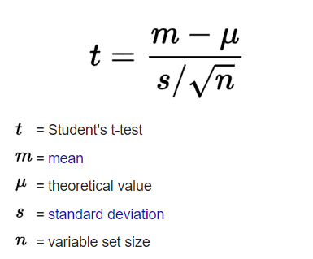
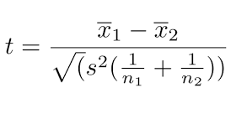
T-TEST
Sample mean
It is the ratio of standard normal variate to square root of the variable set size.
Used to study if there is a statistical difference between two groups
Establishes the problem by assuming that the means of the two distributions are equal

Slide 7
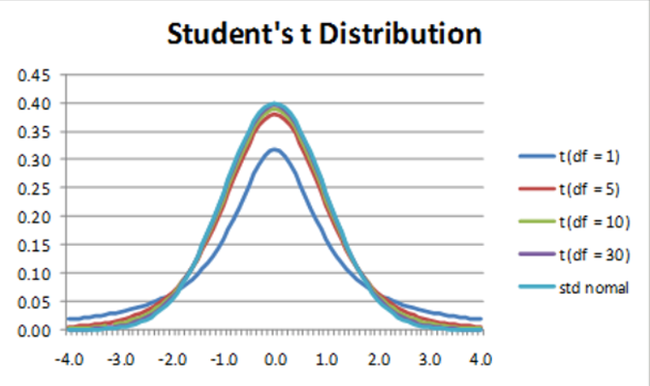
T-TEST
Limiting factor of T-test
The critical value of T
Applications of T-test

Slide 8
ASSUMPTIONS OF T TEST
Data should be continuous
Data should follow a Normal distribution
The data should resemble a bell-shaped curve
A large sample is used
Homogeneity of variance
The parent population from which the sample is drawn is Normal

Slide 9
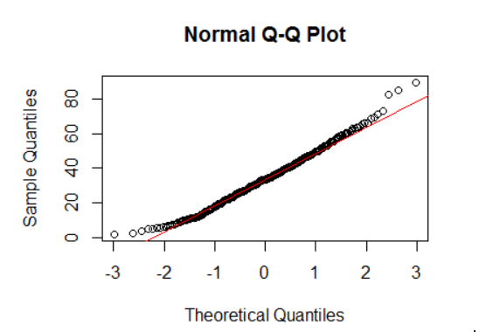
SHAPIRO WILKS TEST
It tests the null hypothesis that a sample x1, .., xn came from a normally distributed population.
If the p-value is less than the chosen alpha level, then the null hypothesis is rejected and there is evidence that the data tested are not normally distributed.
If the p-value is greater than the chosen alpha level, then the null hypothesis cannot be rejected.

Slide 10
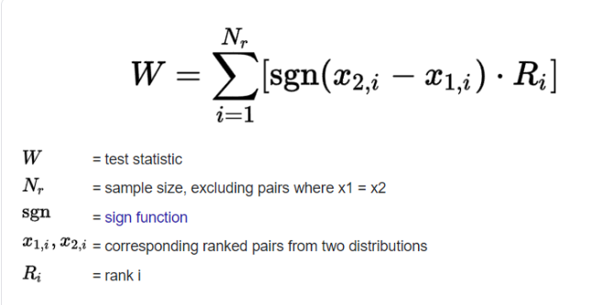
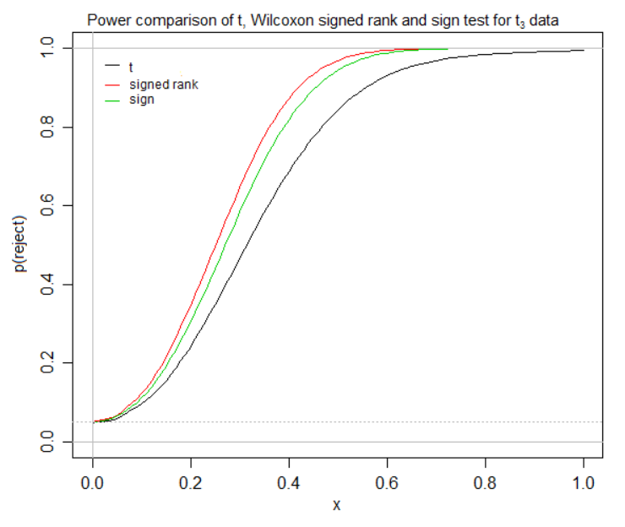
WILCOXON TEST
It is a non-parametric statistical hypothesis test.
It is used either to test the location of a set of samples or to compare the locations of two populations using a set of matched samples.
The Wilcoxon signed-rank test does not assume that the data is normally distributed.

Slide 11
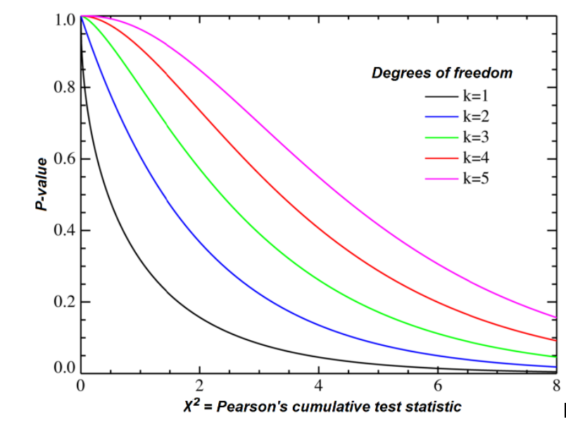
CHI-SQUARE TEST OF INDEPENDENCE
A statistical hypothesis test
For the Chi-square test of independence, we need two variables. Our idea is that the variables are not related.

Slide 12
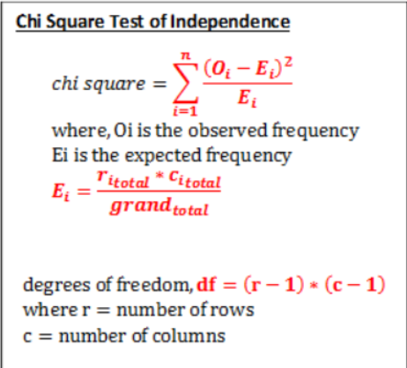
CHI-SQUARE TEST OF INDEPENDENCE
Test Statistic:
To compare actual and expected values
Σ(O-E)*(O-E) / E
where:
O = observed values
E = expected values
i = the number of rows in the table
j = the number of columns in the table

Slide 13
Project Timeline
Chi-Square test of independence
Deriving conclusions from the analysis
Data collection
Preparing the dataset
Shapiro Wilks test
Setting the objective
Data Wrangling
Normality test using QQ plot
Wilcoxon Test
Visualization and interpretation of data

Slide 14
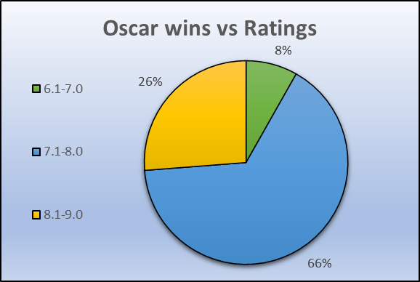
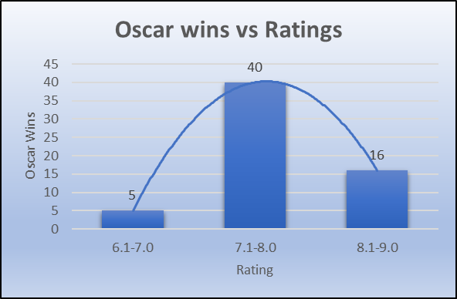
GRAPHS
Oscar wins vs Ratings

Slide 15
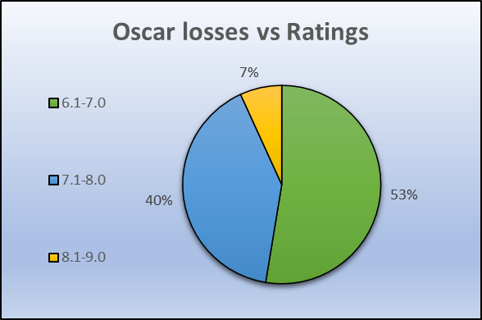
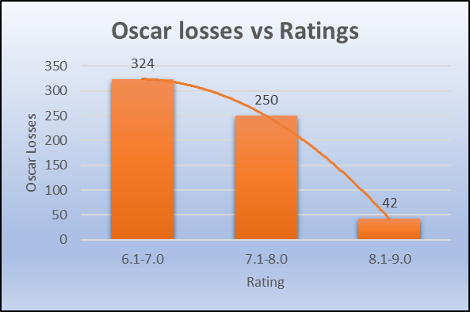
GRAPHS
Oscar losses vs Ratings

Slide 16
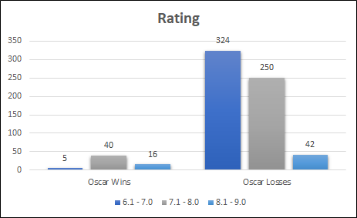
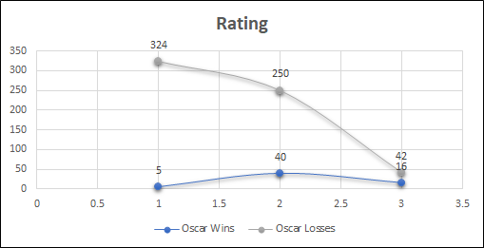
GRAPHS
Oscar wins/losses vs Ratings

Slide 17
INFERENCE
Between Oscar wins and Rating
Between Oscar losses and Rating
74% of the movies that won an Oscar are in the average rating categories (6.1-7.0 and 7.1-8.0)
Movies in the average rating categories (6.1-7.0 and 7.1-8.0) are less likely to win an Oscar than movies in the highest rating category. This implies that even higher rated movies can be snubbed at the Academy awards despite its rating score. But lower rated movies are most likely not to win an Oscar.

Slide 18
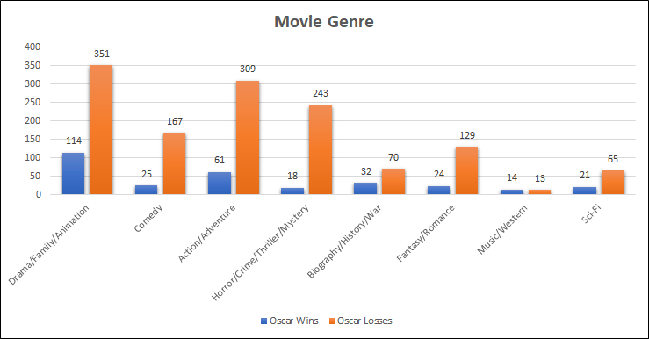
GRAPHS
Oscar wins/losses vs Genre

Slide 19
INFERENCE
Between Oscar wins and Genre
Between Oscar losses and Genre
Movies of the genre Drama/Family/Animation (37%), followed by Action/Adventure (20%) are more likely to win an Oscar than movies of other genre categories. This may be due to the reason that most movies are made under these genres to pander more towards a general audience.
Only 22% of the movies made per year are from the genre Sci-Fi, Fantasy/Romance, History/War, Biography and Music. Hence, the likelihood of them winning an Oscar is also very less.

Slide 20
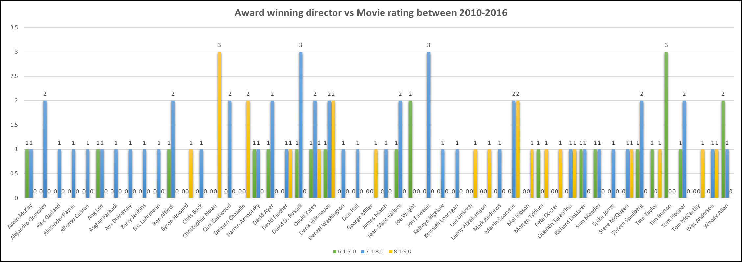
GRAPHS
Award winning directors vs Movie rating between 2010-2016

Slide 21

Data Collection
Methodology
The data for our project was collected from two sources: The IMDB Movie Data set from the Kaggle website which consisted of data scraped from IMDB from 2006 to 2016 and the Oscar data for the winning movies was taken from IMDB’s official website.
Data Wrangling and Preparing the dataset
In this step, we cleaned and converted the data in a format that makes sense to analyze. We considered that some of the variables were irrelevant to the purpose of our project objective and decided to discard them.

Slide 22
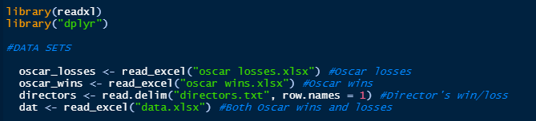
Loading the datasets in R

Slide 23
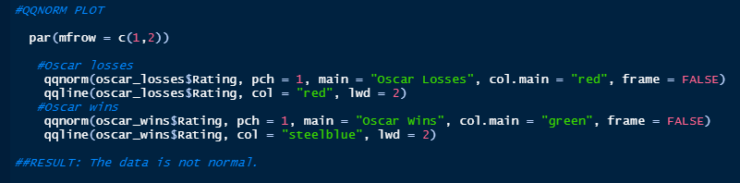
Normality test using QQ plots
Here, the graph was plotted by taking the quantiles of the first data set (Oscar Losses/Wins) against the quantiles of the second data set (Ratings). If the two sets come from a population with the same distribution, the points should fall approximately along this reference line. The greater the departure from this reference line, the greater the evidence for the conclusion that the two data sets have come from populations with different distributions.

Slide 24
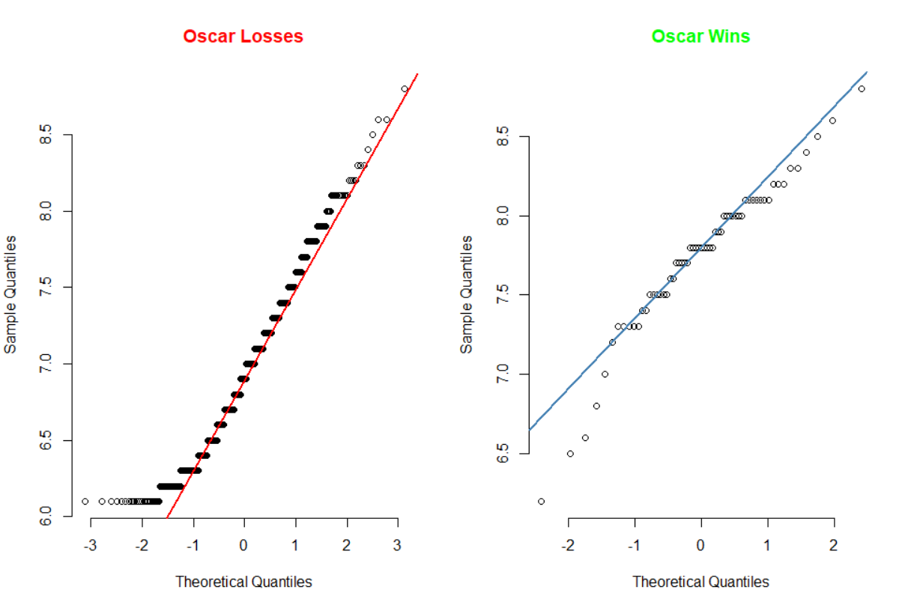
Normality test using QQ plots
Result: Since the points form a curve that deviates markedly from the straight line, we can conclude that the data is not normal.

Slide 25
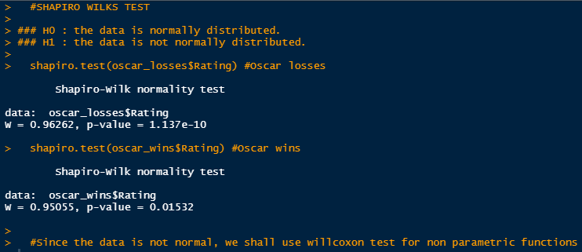
Shapiro Wilks Test
Result: Since the p value < 0.05 in both cases, we reject our null hypothesis i.e. the data is normally distributed.

Slide 26
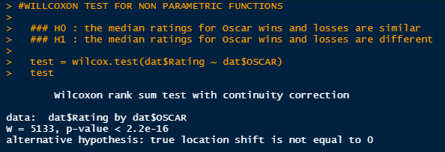
Wilcoxon Test
Result: The alternate hypothesis is accepted i.e. the median ratings and Oscar wins/losses are different.

Slide 27
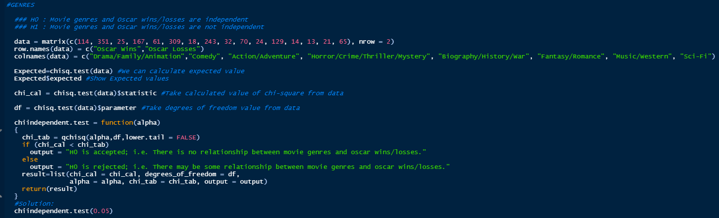
Chi-Square test of independence
Genre vs Oscar wins/losses

Slide 28
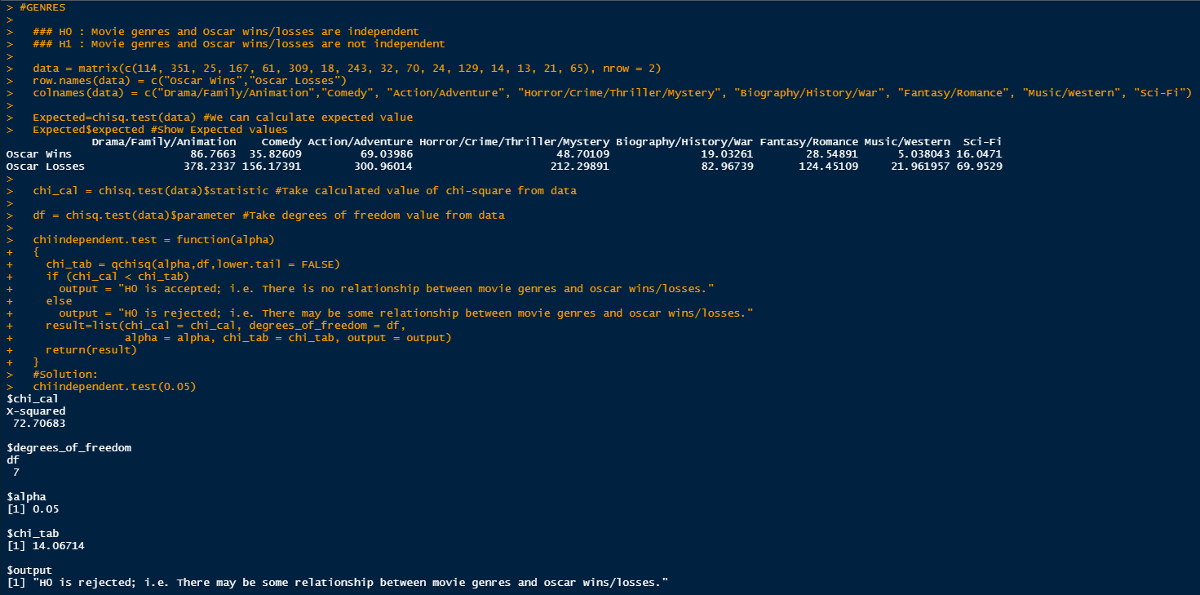
Chi-Square test of independence
Genre vs Oscar wins/losses

Slide 29
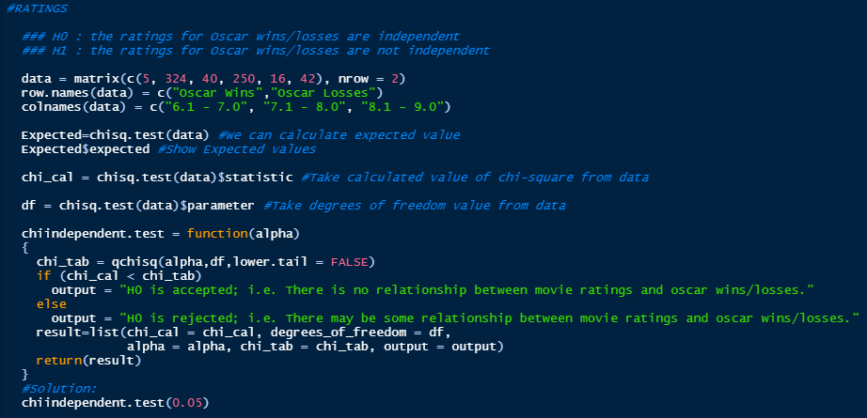
Chi-Square test of independence
Ratings vs Oscar wins/losses

Slide 30
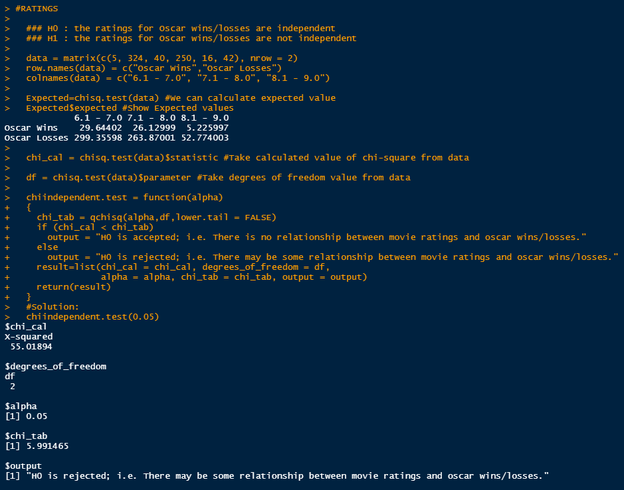
Chi-Square test of independence
Ratings vs Oscar wins/losses

Slide 31
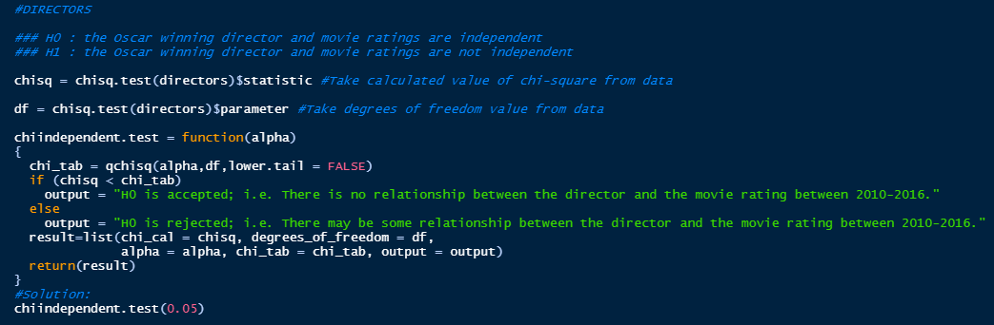
Chi-Square test of independence
Director's win vs Movie rating

Slide 32
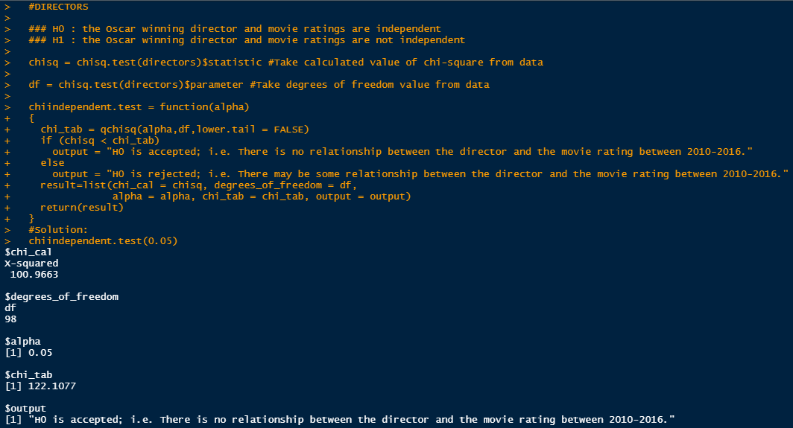
Chi-Square test of independence
Director's win vs Movie rating

Slide 33
Result from Chi-Square test of Independence
The First Analysis of Obtained Results
The Second Analysis of Obtained Results
The Third Analysis of Obtained Results
There may be some relationship between movie genres and Oscar wins/losses between 2010-2016.
There may be some relationship between movie ratings and Oscar wins/losses between 2010-2016.
There is no relationship between an Oscar winning director and the movie’s rating between 2010-2016.

Slide 34

Conclusions
Movies in the average rating categories (6.1-7.0 and 7.1-8.0) are likely to win more Oscars than movies in the highest rating category. This may be due to the reason that average rated movies are directed towards and viewed by a general audience.
Movies under the genre of Drama, Family, Animation, Action, Adventure and Comedy are more likely to win an Oscar as these genres are appealed more by a general audience.
Having an Academy Award winning director directing a movie does not have an impact on its rating and in turn does not influence the movie’s chance of winning/losing an Oscar.

Slide 35



Webliography
For the successful completion of this project, we took help and guidance from the web links as stated below-
Student's T-Test (Introduction, uses, computation, unpaired and paired two sample t-tests, applications, calculations)
Statistical analysis of T-Test (p-value and critical value, t-scores)
Shapiro Wilk Test (Introduction, interpretation, approximation)

Slide 36



Wilcoxon Test (Introduction, procedure, computation)
Chi-Square test of Independence (Introduction, computation, statistical details, understanding p-values)
Chi-Square Test (Chi square test for variance, Pearson’s chi squared test, Binomial tests, Yate's correlation of continuity, applications).

Slide 37




IMDB Movie Data Data set for the project (IMDB data from 2006 to 2016).
IMDB -IMDB’s official website (Oscar data for the winning movies) (Link to Our dataset)
QQ Plot -Introduction to QQ (Quantile-Quantile) plot, its meaning and definition and its application for common distributions.
We also took assistance for various topics from the notes provided by Prof. Sagar Sankeshwari during his lectures and explanations about the same.

Slide 38
Acknowledgement
Appreciation inspiration and motivation have always played a key role in the success of any project.
We feel to acknowledge our indebtedness to our professors, Mr. Sagar S Sankeshwari and Dr. Hemant Kulkarni whose valuable guidance and supervision helped us throughout and shaped the present work in its show.
Lastly, we would also like to thank our parents for their unconditional support.

Slide 39
THANK YOU!

